Slide 1

Brief
This is my week 5 solo project on the QA training course. It involved setting up a database with tables for customers, items and order, and necessitated a go-between table, order_items, to handle an items_orders many to many relationship. Code to produce a variety of functions was needed through Java, and connections required to link the two.

Slide 2
Tools
Throughout this project, I used:
Eclipse as my Java IDE
Junit for testing
Maven for dependencies and build management
Github for repository management
Draw.io for UML and ERD creation
Atlassian Jira and Confluence for my project planning and visualisation

Slide 3
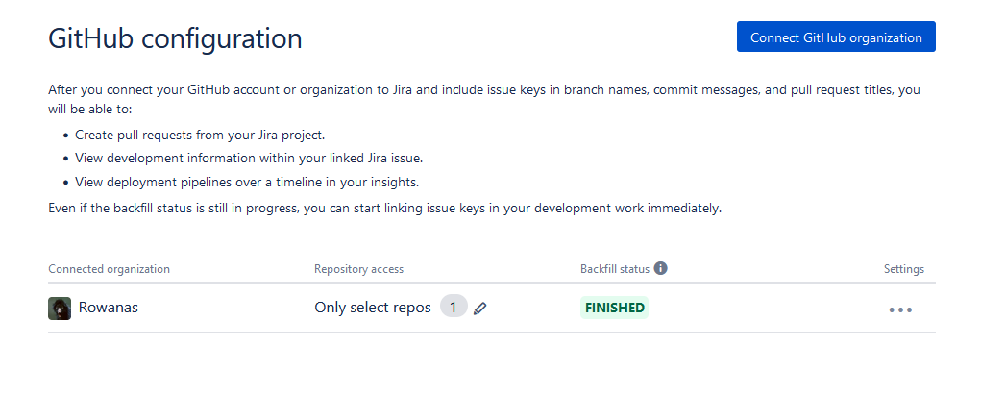
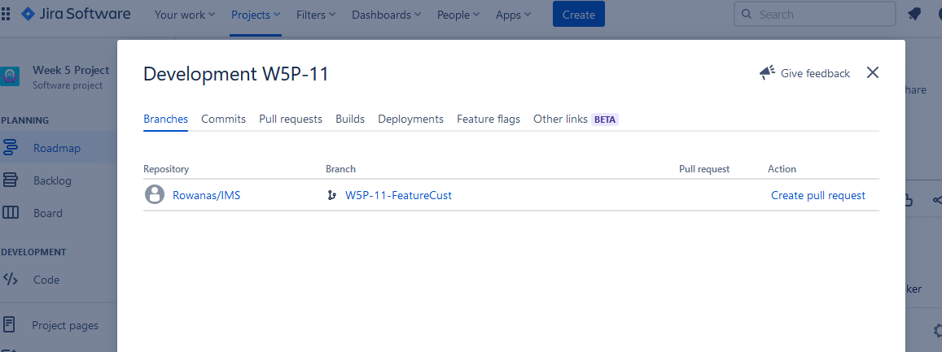
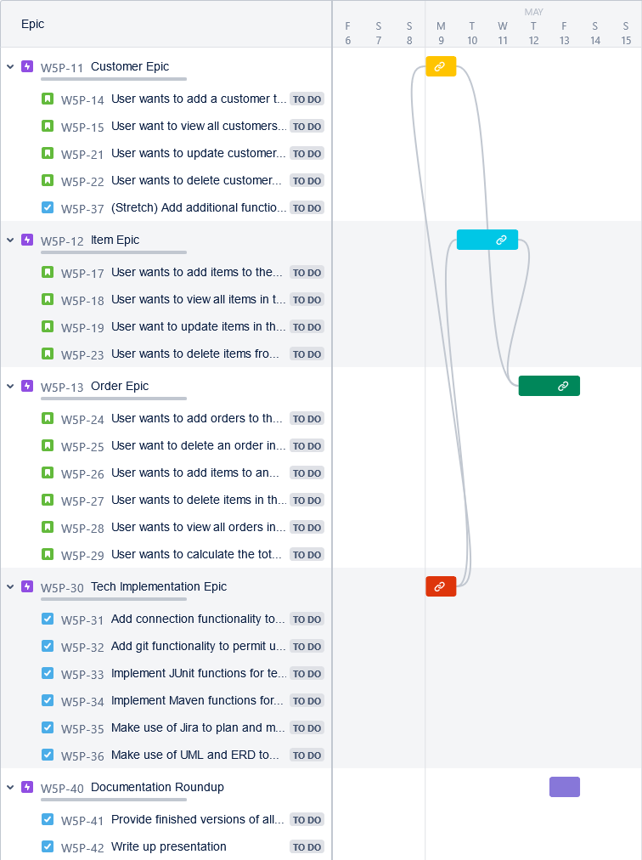
Jira Setup
I set up Jira with Github integration which is a suggested and largely built-in function of Jira, requiring only a confirmation within Github. Form then on, I was able to link branches and commits to the appropriate stories and epics by using the W5P code, as seen below.
https://rowanatwork.atlassian.net/jira/software/projects/W5P/boards/1

Slide 4
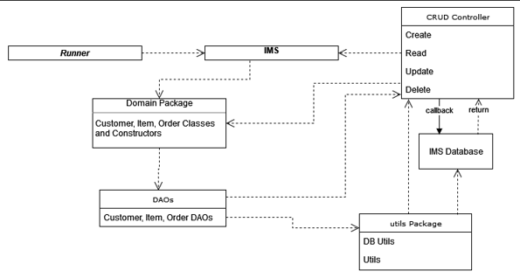
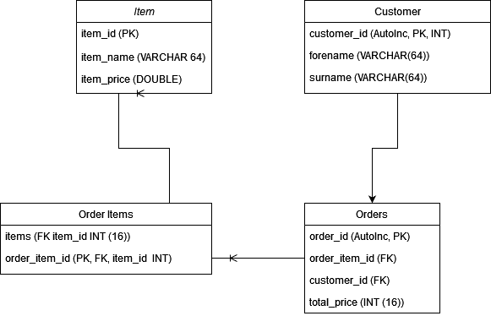
Initial Planning
In my initial planning, I did an extremely bare UML and ERD, not realising that properly mapping the methods would be crucial to later success. My proposed implementation was based on a misconception regarding the nature of many to many relationships, and this cost me some time in backtracking later.

Slide 5
Proposed Implementation
My initial proposed implementation was to have items and customers feed the core information (IDs for both, price and item name for items) to an order_item table which would tot up the total price and provide that plus the IDs to an order table from which everything would be drawn. This proved untenable, and was, looking back at it, logically unsound.

Slide 6
Monday
Monday went extremely smoothly, to the point that I developed neither a diary nor an error log. This was merely reading of the starter code and writing new item code with a few more variables. The methods were simple and issues were simply resolved.

Slide 7
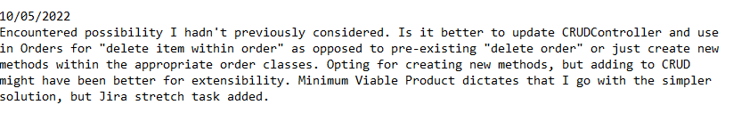
Tuesday
On Tuesday I began in earnest with the Order code, and encountered multiple issues. The CRUD functionality was simple to begin with, but the additional read and update methods began to cause a slowdown as I continued with my proposed implementation. I considered creating new CRUD methods and extending them to my Order class for better future extensibility, but given my tendency to be over-ambitious, I opted for the simpler solution.

Slide 8
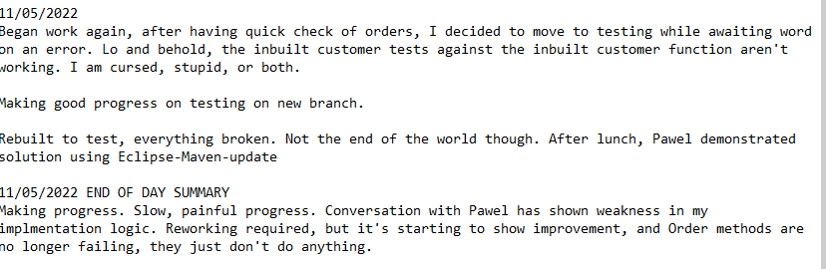
Wednesday
At this point I was beginning to panic until I had a discussion with Pawel and changed my implementation to the one seen today. I worked on my testing partially, setting up a second branch in order to keep my branches clean of non-epic related work. This turned out to be more complex than necessary, but it was a nice idea.

Slide 9
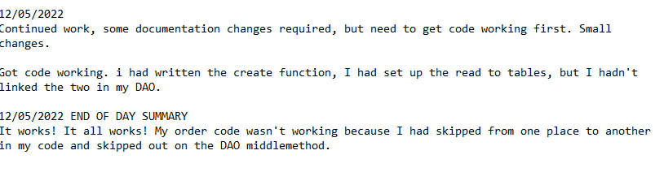
Thursday
Thursday I got it all working! This began my real testing spree, as I had functional code that I could test against. Pressure mounting, as I wasn’t getting to that 80% test coverage. I had several tests on my update code that just wouldn’t work, and I spent hours trying to get the tests to pass, but to no avail.

Slide 10
Friday
I awoke at 6, was at my computer by five past 6, and was typing this presentation out by 20-past.
Initially I was still getting issue with building, as it said there were errors. Pawel suggested changing Maven to 11, and also discovered jacoco error requiring updating to 3.6 as well. Now builds, a mere hour before my presentation! No devlog entry for today, as this more or less covers it.

Slide 11
Project End ERD and UML
Placeholder. Have not finished new UML and ERD up to better standard - for after presentation, my apologies.

Slide 12
Project Summary
In the end, my project bears little resemblance to the initial plan, but I learnt a great deal along the way, both in code and in process. There is too much I would change about my working practices, branch control and error logging to put in a presentation, but my primary takeaway is that I need to devote more time to planning and admin. Devising and creating a proper UML early would have made my logical errors obvious, and saved me time in the long run.

